Slide 1
GOVERNMENT e-tender.
TEAM : C1-07
G.SAI PRANAV
K.MANASA
L.RAKSHITH
M.DEEPESH

Slide 2
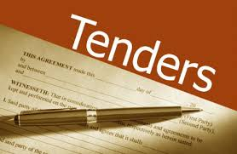
PROBLEM STATEMENT
In tender system the data can be manipulated by the agencies and the bidding amount may be leaked to other companies.
As these are stored as Hardcopies there might be chances of manipulating the bids.
Notes:
How presentation will benefit audience: Adult learners are more interested in a subject if they know how or why it is important to them.
Presenter’s level of expertise in the subject: Briefly state your credentials in this area, or explain why participants should listen to you.

Slide 3
Solution(Existing)
Government has come up with the process of online tenders in which the bid amount must be submitted online.
In this process the bids placed by the contractors is visible to the agency before the bidding time is completed.
By this there may be chances of knowing the least bid to other contractors by which they reduce the bid according to that.
Notes:
Lesson descriptions should be brief.

Slide 4
Solution(proposed)
To overcome this problem, we had developed an application that hides the visibility of the bids and the least bid is taken as the tender by the system itself.
This application keeps the data private and all the extortion is eliminated.
Notes:
Example objectives
At the end of this lesson, you will be able to:
Save files to the team Web server.
Move files to different locations on the team Web server.
Share files on the team Web server.

Slide 5
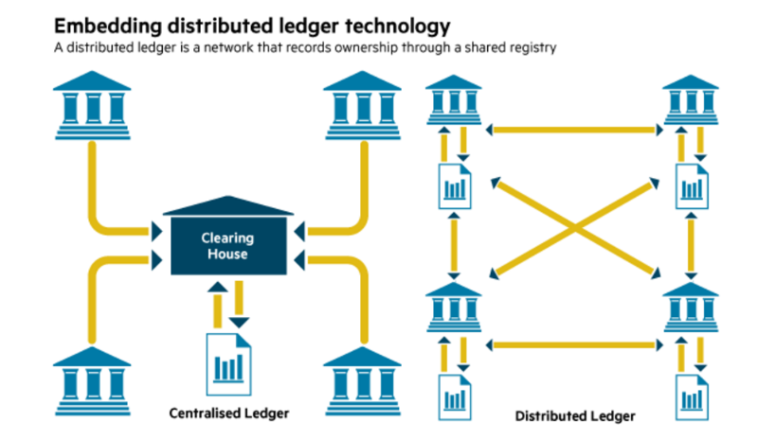
Properties of blockchain used.
Distributed Ledger
Highly secure
Transparency

Slide 6
Thank you

